Slide 1
Covid-19 Testing

Slide 2
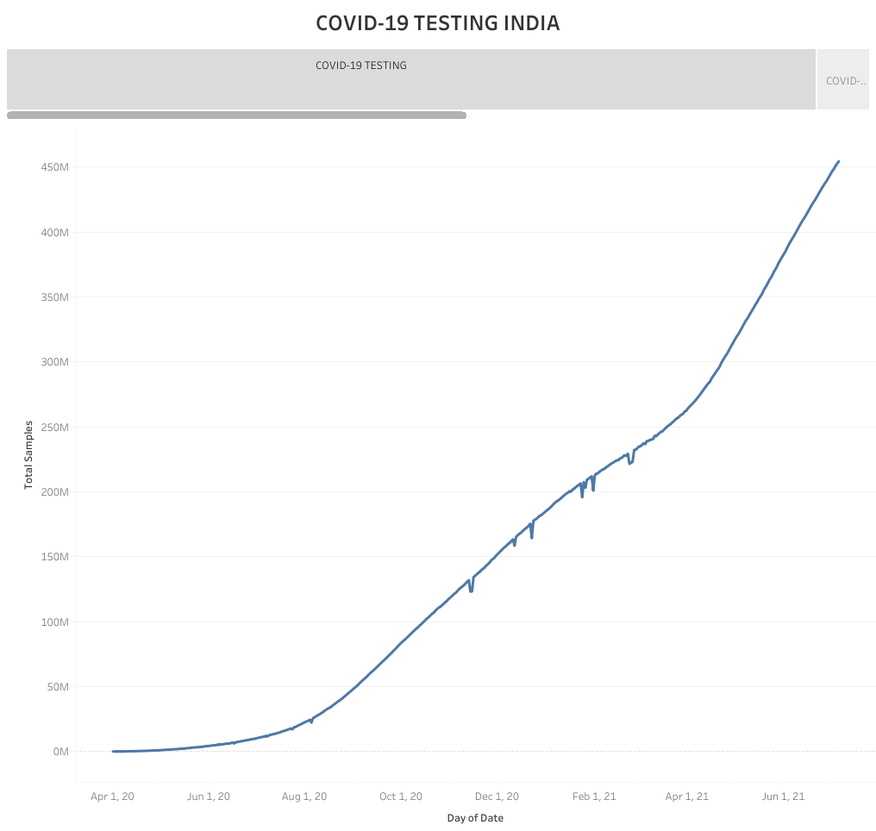

Slide 3
